Slide 1
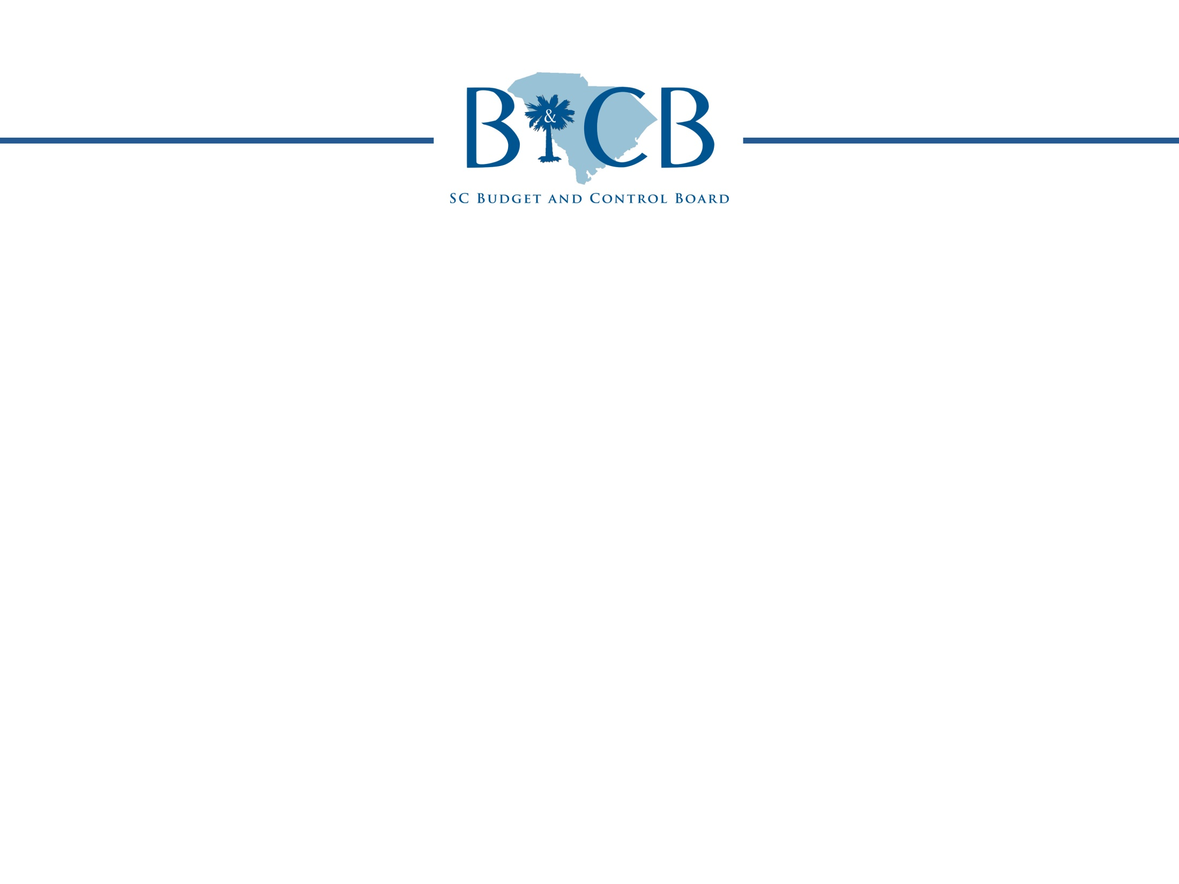
Cyber Security Project Update
Marcia Adams
SC Budget and Control Board
Senate Finance Committee
April 16, 2013

Slide 2

Agenda
Contract Information
Project Activities and Timeline
Project Status
Fiscal Impact - S.334

Slide 3
Contract Information
Contract authorized by 5 member Budget and Control Board
Contract awarded in accordance with State Procurement Code to Deloitte and Touche on March 22, 2013
Contract Value: $2,998,000
Source of funds: Statewide account for employer contributions used per Proviso 80A.25 of the 2012-2013 Appropriations Act
Contract Term: 3 years (March 22, 2013 – March 2016)

Slide 4
Project Activities and Timeline
Objective: Develop and assist in the implementation of a statewide information security (INFOSEC) program and assist in identifying and addressing serious information security vulnerabilities.
Work will be completed through 2 Phases of Project (Task “A” and Task “B” Activities)
Deloitte began work on March 22, 2013

Slide 5
Project Activities and Timeline
Task “A” Activities – To be completed by May 1, 2013
Identify the State’s most serious security vulnerabilities
These vulnerabilities will be identified, in part, by conducting 3 agency security/risk assessments. The agencies are:
  Budget and Control Board
  DHEC
  Probation Parole and Pardon Services
Provide recommendations to address most serious vulnerabilities
Provide budget estimates associated with recommendations for FY14
Provide a high level governance structure for managing security statewide (a model for managing IT security throughout the state)
Provide a report to the Budget and Control Board and the General Assembly on May 1, 2013

Slide 6
Project Activities and Timeline
Task “B” Activities – To be complete by March 2016
Develop a Statewide Information Security Program
Conduct an additional 15 agency assessments and continue to identify security threats/risks (These assessments will begin after May 1, 2013)
Provide recommendations to mitigate identified threats/risks
Develop enterprise security policies, procedures and standards
Develop a data classification schema (Help agencies determine what data they have and what state/federal/industry compliance requirements must be met)
Provide security awareness training recommendations
Provide staffing recommendations for statewide security program
Develop and assist with implementation of governance structure and operating model for the management of information security
Provide annual funding estimates

Slide 7
Project Activities and Timeline
The contract allows other agencies (other than the 18 selected) to contract with Deloitte to complete an assessment. Hourly rates have been negotiated and are included in the contract.

Slide 8
Project Status as of 4/16/13
Timeline impacted, address ASAP
Timeline may be impacted
On schedule, no major issues
Project milestone not started
Highlights
Status | Milestone | Start | End | %
 | Kick off with each agency | 3/25 | 3/27 | 100
 | Immediately Address Serious Security Vulnerabilities | 3/26 | 4/25 | 60
 | Security Risk Assessments | 3/26 | 4/25 | 60
 | Strategy and Recommendations | 3/26 | 5/01 | 40
Vulnerability Assessments ongoing. Focus on technical controls in place at agency
Risk Assessments ongoing. Required interviews, workshops and meetings are complete. Deloitte is analyzing information gathered. Focus on operational and management controls in place at agency
Development of strategies and recommendations to resolve detected issues and “themes” identified across the three agencies is ongoing
Governance sessions in process and interviews with CISO’s of MN, PA, and MI have been completed
Notes:
8

Slide 9
S. 334 – Fiscal Impact
Section 3.A Information Security
  Salary for 6 positions $981,800
  Contributions @ 31% $304,358
  Recurring Operating Costs $108,548
  Annual Security Conference $20,000
  Non-Recurring Start-up Costs $70,032
Article 3 Technology Investment Council
  Add the following language to Article 3: “Upon funding from the General Assembly, the council may engage or employ staff or consultants as may be necessary and prudent to assist the council in performance of its duties and responsibilities.”
  Estimated Consultant Costs $98,784
Chapter 79 Joint Information Security Oversight Committee
  Consultant Cost $49,392
  Subsistence for 8 committee members $6,816
Grand Total $1,639,730

Slide 10
S. 334 – Fiscal Impact
Fiscal Impact for Division of Information Security may change based upon project recommendations regarding duties, roles, and responsibilities of this office
Additional operational duties (such as network monitoring, forensic analysis, breach response, Privacy Officer, etc.) would increase cost estimates

